Slide 1
Bitcoin Trading Agent
Regis University
MSDS 696
Data Science Practicum II
by Evrim Akgul

Slide 2
01
Introduction
Overview
- Myself
- Background
- Project
02
About the Agent
- Purpose
- Expectations (What does it do)
- Limitations (What does it not)
03
Components
- Time-Series
- Reinforcement Learning
- Deep Q Networks (DQN)
04
Data
- Source (Binance)
- Exploratory Data Analysis (EDA)
05
Conclusion
- Results and Findings
- Challenges
- Lessons
- What is next?

Slide 3

Introduction
Bitcoin Trading Agent
Reinforcement Learning
Self-Learning
Trial-and-Error
Myself
Economics
Finance
Time-Series
Neural Networks
Background
Reinforcement Learning Class
* Exchange Rate Prediction – Practicum I
Trading Friends
* https://github.com/evrimakgul/Exchange_Rate_Prediction

Slide 4
About the Agent
01
Purpose
02
Expectations
03
Limitations

Slide 5
Purpose
A
Bitcoin Trading Agent
A
Profiting
B
Executing Successful Trades
Deep Q-Learning
B
C
Self-Learning, Action Based Modelling
C
Model Free Agent
D
No Pre-determined Policy
D
E
Reinforcement Learning
E
Experience Gain

Slide 6
Expectations
Developing a profiting trading agent in Bitcoin market
- Profiting
- Both exploratory and exploitative actions
- Both successful and unsuccessful trades
- Setting up a winning rhythm

Slide 7
Limitations
First of all, this agent will neither be golden goose nor aiming to make myself or somebody else rich. Financial markets - Cryptocurrency markets included - are complex structures and have unpredictable grounds. To profit in such an environment repeatedly and continuously is not an easy task, if not possible at all.
Technical Analysis
Fundamental Analysis
Deep Q Network
Personal Workstation
Companies with investment strategies, are using hundreds of indicators (technical or fundamental) in their strategies. Usually, pruning them with methods such as decision-trees and that is how they get their investment decisions,
The purpose of this project is to show that an algorithmic approach that can come up with a strategy not predetermined is also an option. Yet it should not be expected as successful or consistent, due to the fact that it will not be as richly fed or supported.

Slide 8
01
Time-Series Analysis
Components
02
Reinforcement Learning
03
Deep Q Networks (DQN)

Slide 9
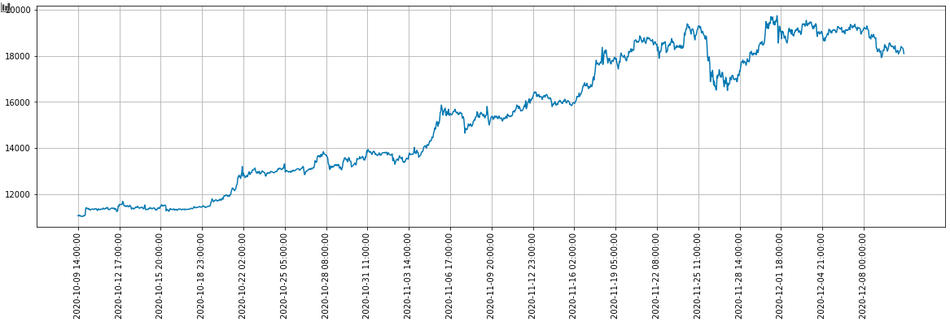
Time-Series
Time-Series are like any other data except that the they occur in sequence. This sequence harboring nature is what makes it special, relatively.
Hourly closed values of Bitcoin studied in the project.

Slide 10

Reinforcement Learning
Source
(Sutton & Barto, 2018)

Slide 11
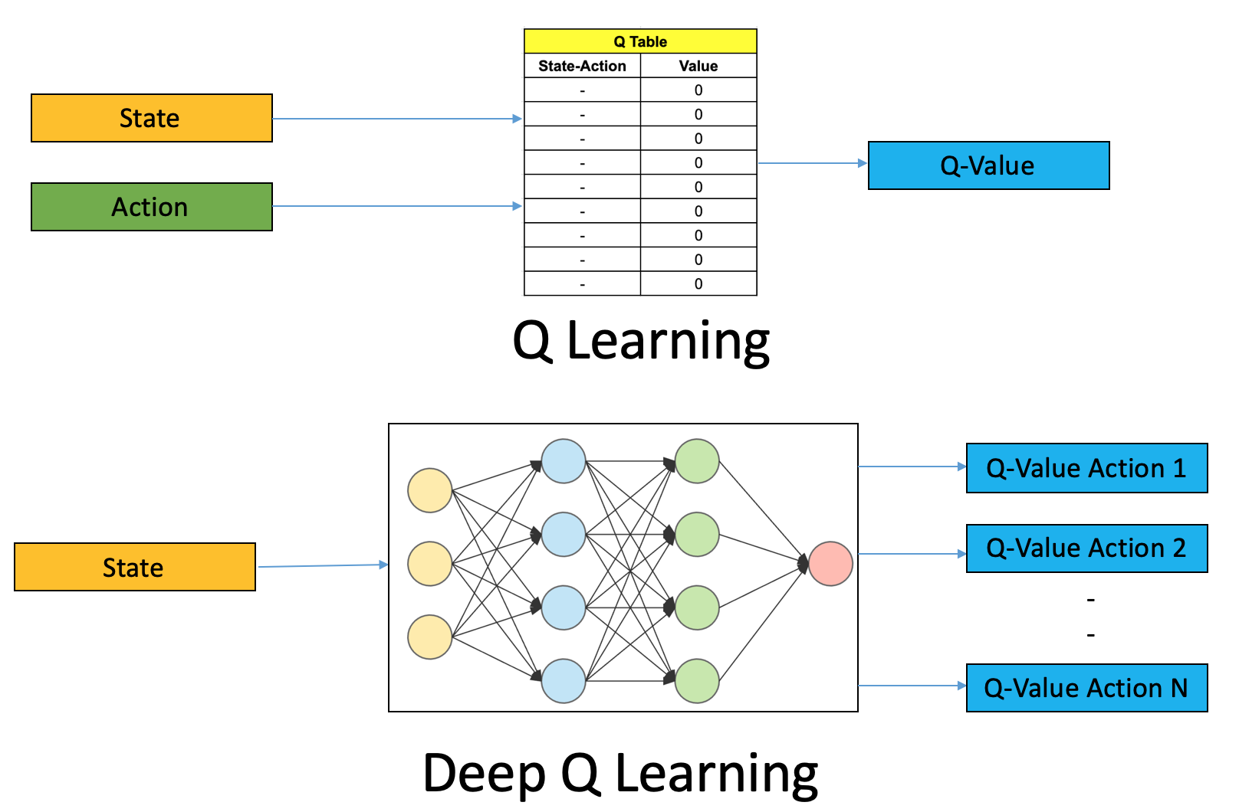

Slide 12
01
Source
The Data
02
Exploratory Data Analysis
(EDA)

Slide 13
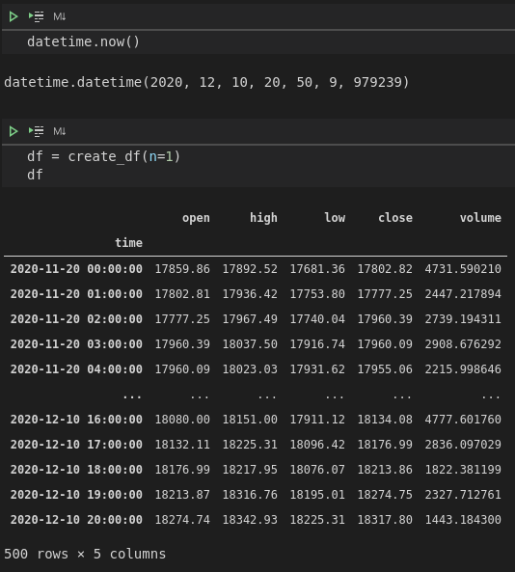
Binance
A piece of code is providing n batch of current data collected from Binance Cryptocurrency Market. One batch has 500 data points in it. For instance, this given data example is from 20 Nov 2020 to 10 Dec 2020.
Dataframe
Another integrated code converts the collected data into a dataframe one like given on the left
Candle Statistics
The provided data has typical candle information and it is hourly. Other optional time sequences are also available.
Data Example

Slide 14
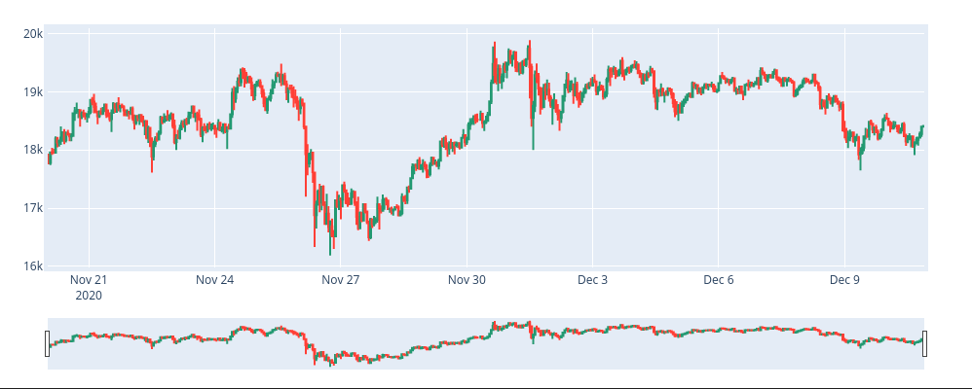
Exploratory Data Analysis (EDA)
This is a typical candle chart of our data showing price movements in respect to its (O)pen, (H)igh, (L)ow, (C)lose and (V)olume data (OHLCV).
Candle Chart

Slide 15
01
Results and Findings
Conclusion
02
Challenges
03
Lessons
04
What is next?

Slide 16
Results and Findings
Executed Buys
Between 2020-09-06 and 2020-10-15 61 trades, 0.46
buy_succeeded: 35, buy_failed: 26
Between 2020-10-15 and 2020-11-25 64 trades, 0.47
buy_succeeded: 9, buy_failed: 2
Between 2020-11-25 and 2020-12 11 trades, 0.55
buy_succeeded: 39, buy_failed: 25
154
Buys
48%
Sells
167
52%
Executed Sells
Between 2020-09-06 and 2020-10-15 71 trades, 0.54
sell_succeeded: 37, sell_failed: 34
Between 2020-10-15 and 2020-11-25 73 trades, 0.53
sell_succeeded: 3, sell_failed: 6
Between 2020-11-25 and 2020-12 9 trades, 0.45
sell_succeeded: 40, sell_failed: 33
.

Slide 17
Results and Findings
01
Total Succeeded/Failed Trade
02
Success Rate
171 / 150
53%
03
Total Capital Gain Ratio
04
Capital At The End
11.21%
11120.28
3.67 Step
324 / 1190
11880
9854
Average Trade Length
Max Capital
Min Capital
Total Episode / Step
.
.
.
.

Slide 18
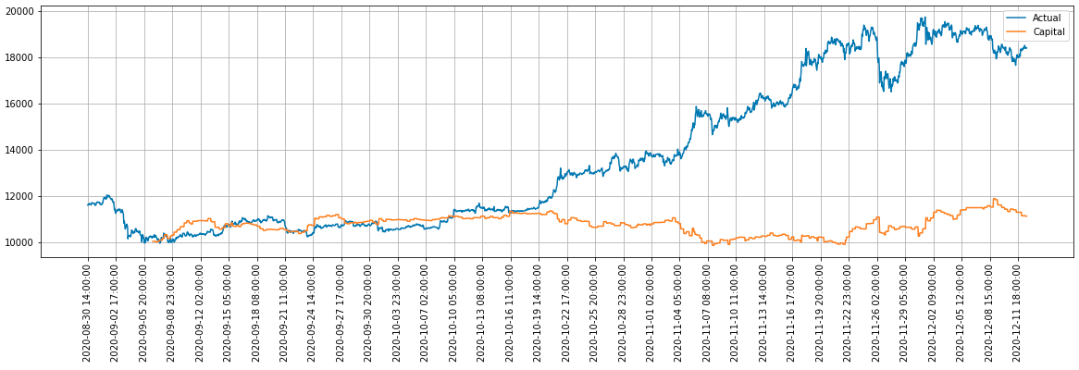
Results and Findings
This is a similar summary as I had from my previous observations. I had the chance to run the data more than 15 times with different settings. As the length of the data shortens (thus the run time and trainings) general outcome turns to profit. Yet, we can see that a buy and hold strategy (at the beginning) would be a better choice. It seems there are more to be done with this work.
Capital Change across Bitcoin price movement

Slide 19
Challenges
Lack of Educational Material
Time Constraint
Long Training Spans (over a minute per episode)
Vast Amount of Possibilities

Slide 20
Lessons Learned
More Exploration
There are so many different options to be taken. It seems as if it is a must to extend the span of the project.
Giving more time to test different ideas
Better Time Management
The nature of the project requires a lot of time. Trying to squeeze it longer but sparse time frames is not smart.
I struggled with this a lot. This type of project is more marathon then a sprint.
Coding Quality
Related to the long training periods, effective coding makes significant impact.
This is an important aspect of this project due to the fact that trainings take long time.
Providing generic and simpler data (such as a sinus function) to train the agent in the beginning seems a good option.
Simpler Models
Simpler models seems better to teach patterns to the agent.
I observed some interesting actions that are contradicting with common sense. The rewarding mechanism could be the answer to such weaknesses.
Contradicting Actions
Agent can act against the common sense.

Slide 21
What is next?
Limitless
1
An Idea
4
Options and alternative strategies seems infinite. That is promising for many opportunities.
An alternative rewarding mechanism that is encouraging less but emphasizing quality transactions.
Indicators
2
Different States
5
Using alternative fundamental and technical indicators first thing that comes to mind.
States are the knowledge feeding the agent. Catering the agent with different states might be also a good choice.
3
6
Alternative Rewarding
Incremental Training
Reward mechanism is the key factor in Reinforcement Learning. Utilizing this with alternatives seems only logical.
Training the agent with models that are getting incrementally complex.

Slide 22
THANK YOU
Insert the Subtitle of Your Presentation

